Slide 1

Okiełznaj siłę narowistych
strumieni
Bartłomiej Michalski
Kamil Dworak

Slide 2
Who we are?
FP Data Solutions
DEV ENV
Our experience

Slide 3
Your experience and expectations ?
Who are you?
What are you expecting from us?

Slide 4
Agenda
Big Data – quick overview
Stream Data Processing – about real data
Azure Components – services overview
Realtime systems and tools
Create scalable application to proces data in On-line and Off-line mode based on Azure cloud.

Slide 5
Goals
Share knowledge about big data and
stream data processing
Exchange experience
Have fun

Slide 6
Big Data - introduction

Slide 7
163 Zetta bytes by 2025
163 Zetta bytes =
163 000 000 000 000 000 000 000 bytes
163 *2⁷⁰ bytes 163 * 1024⁷ bytes
If 1 bytes = One grain of rice
then Zetta byte = Fills the Pacific Ocean
Watching the Netflix catalog
489 million times

Slide 8
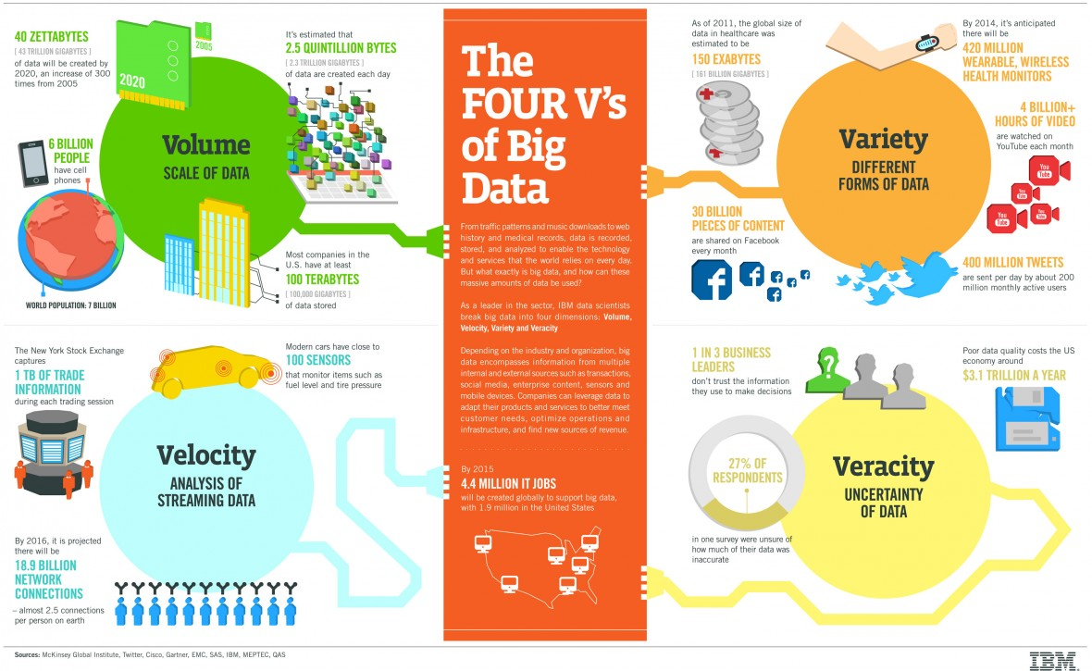

Slide 9
3Vs of Big Data
Data Volume
Byte One grain of rice
Kilobyte Cup of rice
Megabyte 8 bags of rice
Gigabyte 3 semi trucks
Terabyte 2 container ships
Petabyte Blankets Manhattan
Exabyte Blankets west coast states
Zettabyte Fills the Pacific Ocean
Yottabyte As earth-sized rice ball
Data Variety
Structured
Unstructured
Semi-structured
All the above
Data Velocity
Near to Real Time
Batch

Slide 10
Lambda Architecture
COLD PATH
Input Data
All Data
Precomputed Views
BATCH LAYER
Batch View
Queries
Real Time View
Recent Data
Incremental Views
SPEED LAYER
HOT PATH

Slide 11
Stream Data Processing

Slide 12

Źródło: www.com-strat.com

Slide 13
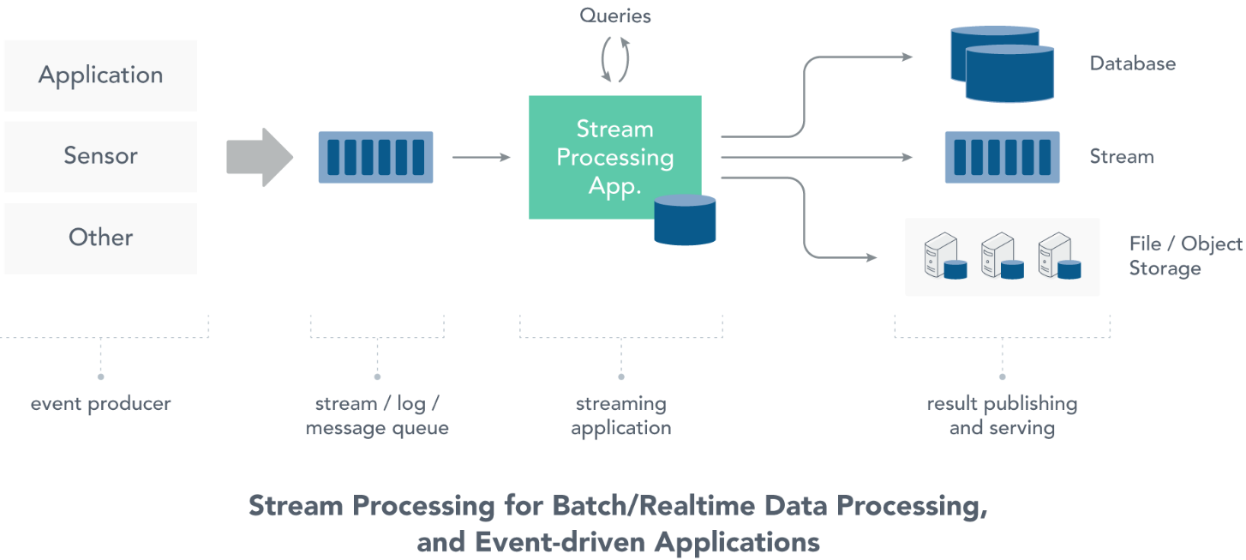
Stream Data Processing
Źródło: www.ververica.com

Slide 14
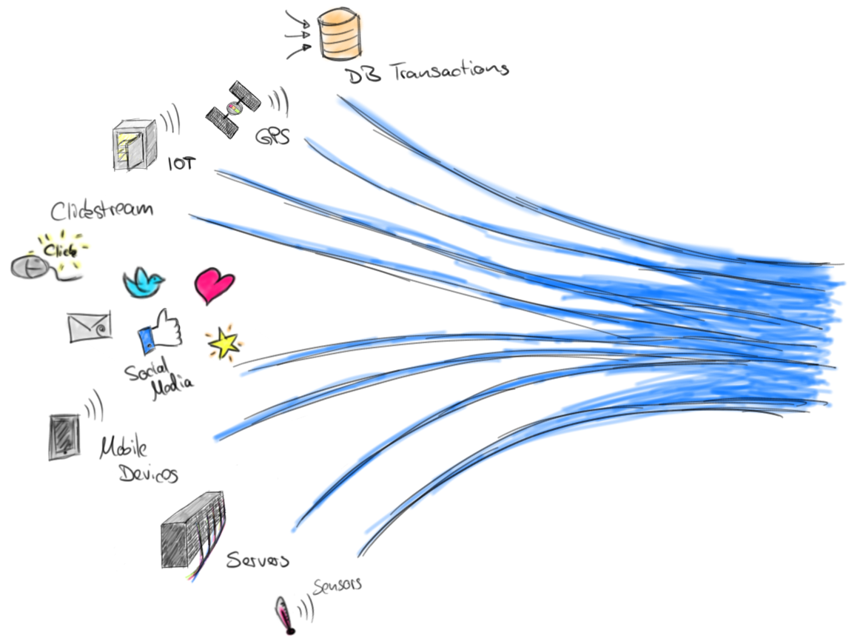
Stream Data Processing
Theoretically infinite data stream
Access to data is instant
Processing must take place
as soon as possible
The status and size of the data
is unknown
Źródło: flink.apache.org

Slide 15
Batch processing vs. Real time processing
Batch processing
Static Datasets
Quering large amount of data can be noneffective
Real time processing
Dynamic and moving data
Unlimited data
Fast In/Fast Out

Slide 16
Your today task

Slide 17
Your today task
We create a competitive service to uber. We want to be better and faster in providing tailored services to our clients.
We are taking over a taxi fleet in New York and want to respond quickly to what is happening. We want to detect potential problems at the end of each course that could lead to our clients leaving us. In addition, we want taxi drivers who work better to be rewarded quickly. We have a lot of data, but for now we do nothing with them, and we want to improve the level of our services.

Slide 18
Your today task
Nonfunctional requirements:
There are about one milion taxi cabs.
In future we want also to handle fleets in other cities.

Slide 19
10 minutes - design a solution for this problem

Slide 20
Generating Data
It is all about data

Slide 21
Azure Services

Slide 22
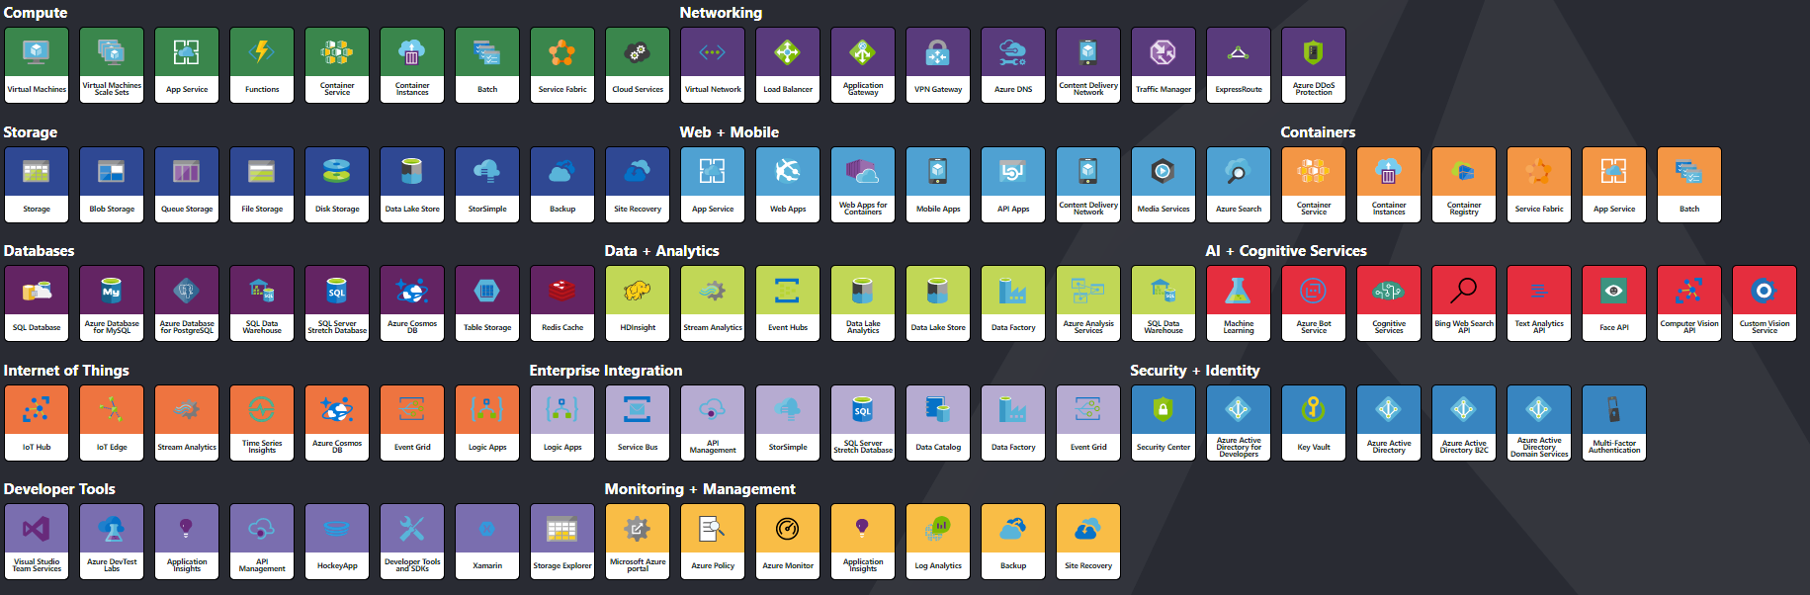
Azure – Services

Slide 23
What to look for?
Data transfer from devices
Extensive data storage (TB – PB)
Processing large data sets
Selected algorithms for analyzing
measurement data
Scalability

Slide 24
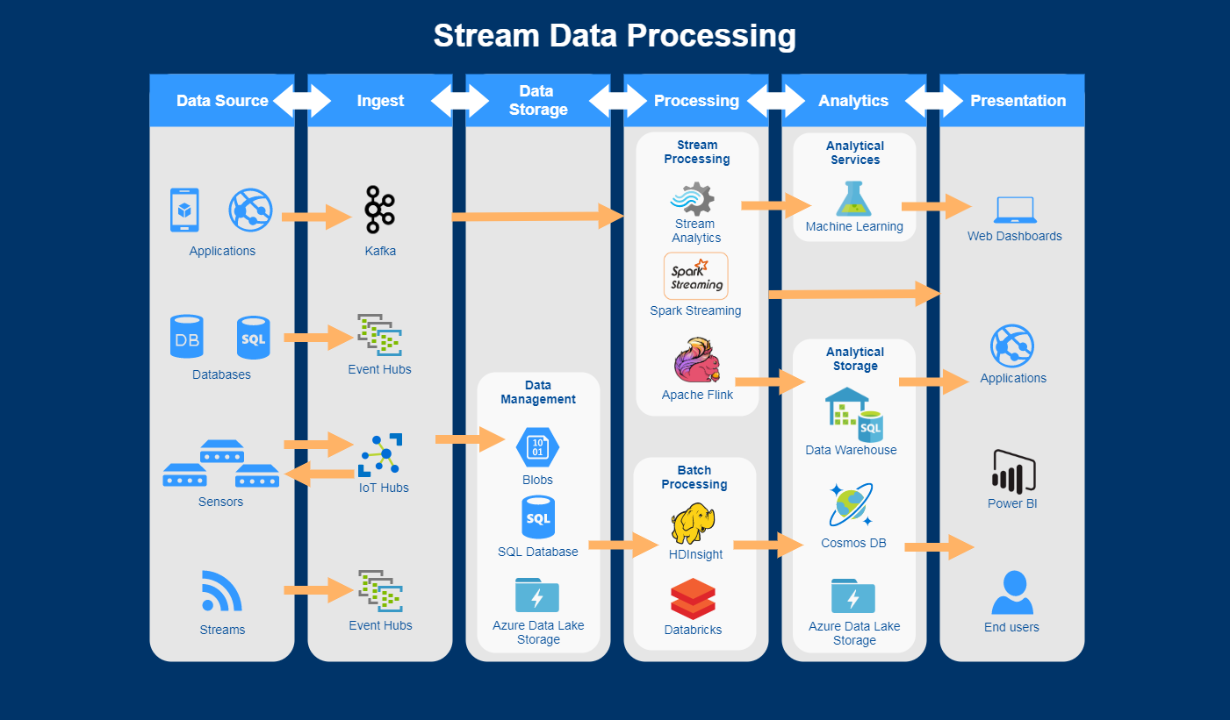
Azure – Services

Slide 25



What overbalance the cloud?
Unlimited storage
Unlimited computing power
Productivity
Much lower entry threshold
High scalability and performance
SLA
Data safety
Data replication

Slide 26
Ingest

Slide 27

Azure Event Hub
Allows to get millions of
messages per sec.
Fully scalable
Kafka protocol support
AQMP and HTTPS support
Event Capturing
Data is partitioned

Slide 28
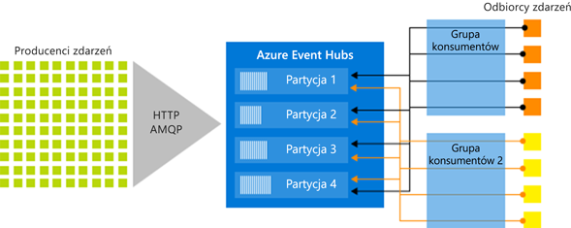
Azure Event Hub
Źródło: docs.microsoft.com

Slide 29

Azure IoT Hub
Two-way communication
MQTT support
The ability to send files
Configuration of individual identities

Slide 30
Azure Event Hub vs IoT Hub
Azure Event Hub is a highly scalable data streaming platform and event ingestion service, capable of receiving and processing millions of events per second
Azure IoT Hub is a fully managed service that enables reliable and secure bidirectional communications between millions of IoT devices and a solution back end
Area | IoT Hub | Event Hub
Device protocol support | Supports MQTT, MQTT over WebSockets, AMQP, AMQP over WebSockets, and HTTPS. | Supports AMQP, AMQP over WebSockets, and HTTPS.
Device state information | Device twins can store and query device state information. | No device state information can be stored

Slide 31

Apache Kafka
Distributed and scalable
message broker
Application in Big Data projects
Publisher-subscriber model
Guaranteed message delivery
It allows to work in batch mode

Slide 32
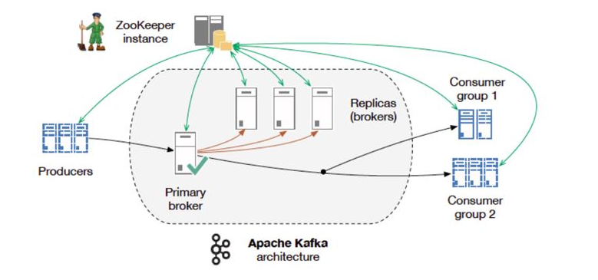
Apache Kafka
Źródło: www.prathapkudupublog.com

Slide 33
Exercise Simulator / Event Hub / Apache Kafka

Slide 34
Storage

Slide 35

Azure Blob Storage
Simple and scalable data storage
Data without a specific schema
Automatic replication
Integration with almost each Azure service

Slide 36

Azure Data Lake Storage
Highly efficient and optimized storage
for a large data volume
Automatic data replication
Scalability
Data partitioning
Very good integration with HDFS
Theoretically unlimited data storage

Slide 37


Azure – Big Data Storage
Azure Blob Storage
Azure Data Lake Storage (Gen1)
General purpose object store
Object store with flat namespace
Hot/cold/archive tiers
Data replication and redundancy options
Unlimited storage, petabyte files
WebHDFS-compatible REST interface
Hadoop and big data optimizations
Supports files and folders objects
Azure Data Lake Storage (Gen2)
Multi-modal combining features from both of the above
Not a separate service: Azure Storage with new features

Slide 38
Azure Data Lake Store (Gen1 & Gen2)
Built for Hadoop
WebHDFS-compatible REST interface
Unlimited storage, petabyte files
Highly-available and secure
Supports files and folders objects
Files are split apart into Extents (250 MB)
For availability and reliability,
extents are replicated (3 copies).
Enables: Parallel read and Parallel write

Slide 39

Azure SQL Server Database
Quick access to selected data
Inteligent query processing
Smart performace tuning
Monitoring
Scalability

Slide 40
Processing

Slide 41
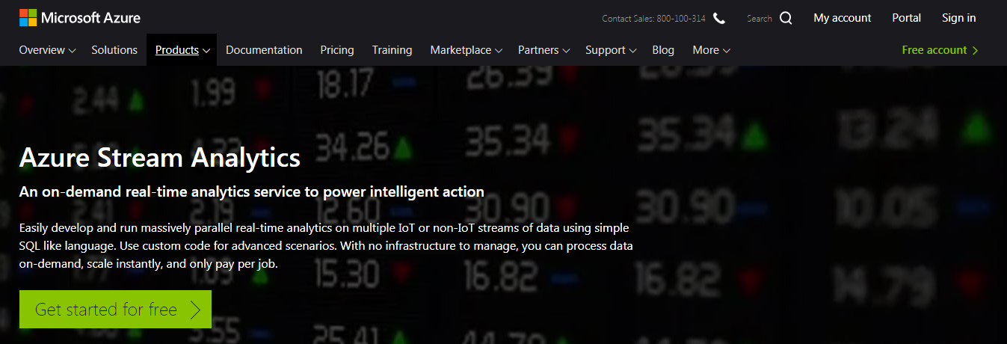
Azure Stream Analytics
https://azure.microsoft.com/en-us/services/stream-analytics/

Slide 42
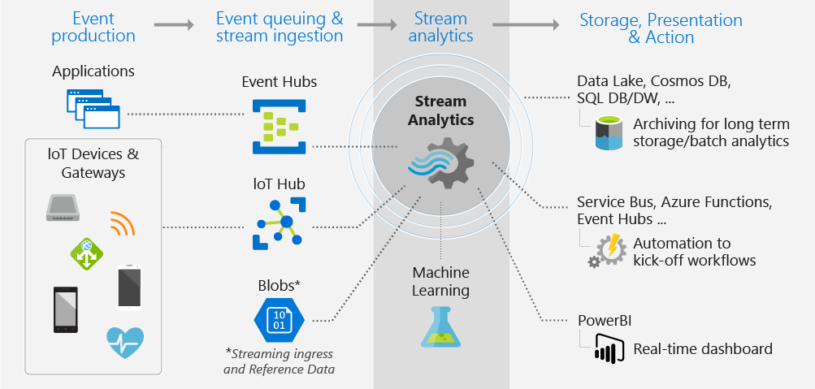
Azure Stream Analytics
https://docs.microsoft.com/en-us/azure/stream-analytics/stream-analytics-introduction

Slide 43
Azure Stream Analytics Query Language (1)
Query Language Elements – APPLY, – CASE, – CREATE TABLE, – FROM, – GROUP BY, – HAVING, – INTO, – JOIN, – SELECT, – UNION, – WHERE,
– WITH
SELECT *
INTO [SweetsRawCsvData]
FROM [SweetsMachinesEvents] AS se
TIMESTAMP BY EventTime
SELECT SerialNumber
,max(EventValue1) AS MaxTemp
INTO [SweetsRawCsvData]
FROM [SweetsMachinesEvents] AS se
GROUP BY SerialNumber, TumblingWindow (hour, 2)

Slide 44
Azure Stream Analytics Query Language (2)
Date and Time functions – DATENAME, – DATEPART, – DAY, – MONTH, – YEAR, – DATETIMEFROMPARTS, – DATEDIFF, – DATEADD
Aggregate functions – AVG, – COUNT, – Collect, – MAX, – MIN, – SUM
String functions – CONCAT, – LEN, – LOWER, – REGEXMATCH, – SUBSTRING, – UPPER
Window functions – Hopping Window, – Session Window, – Sliding Window, – Thumbling Window
Conversion functions – CAST,
– GetType,
– TRY_CAST

Slide 45
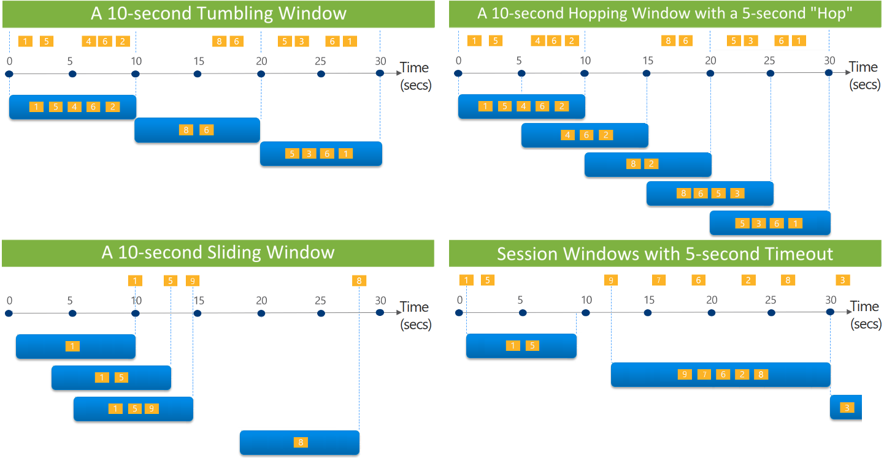
Window Types
https://docs.microsoft.com/en-us/azure/stream-analytics/stream-analytics-window-functions

Slide 46
Exercise Azure Stream Analytics

Slide 47



Spark on Azure
OR
Azure HDInsight
Azure Databricks

Slide 48

Azure SQL Server Database
Optimized Apache Spark environment
Automatic scaling
Simple integration with other
PaaS services
Allows real-time analysis
Built in machine learning algorithms
Support for many programming languages

Slide 49
Azure Databricks
Azure Databricks is an Apache Spark-based analytics platform optimized for the Microsoft Azure cloud services platform
Integration with Azure services:
SQL Data Warehouse
Cosmos DB
Data Lake Store
Blob Storage
Event Hub
Integration with Azure Active Directory
Notebooks : R, Python, Scala, or SQL

Slide 50
Apache Spark - Marketing
Apache Spark™ is a unified analytics engine for large-scale data processing.
Speed
Easy of use
Generality
Runs Everywhere

Slide 51
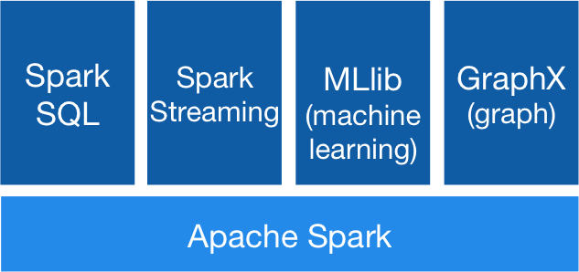
Apache Spark - Stack
https://spark.apache.org/images/spark-stack.png

Slide 52
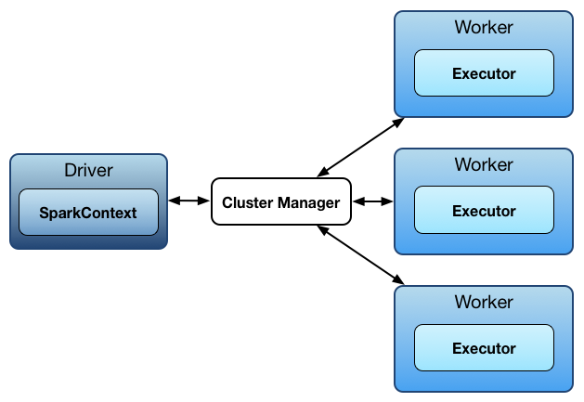
Apache Spark - Architecture
https://jaceklaskowski.gitbooks.io/mastering-apache-spark/spark-architecture.html

Slide 53

Apache Spark – Hosting
http://www.agildata.com/wp-content/uploads/2016/03/Blog-InlineIMAGES-ClusterManagement.png

Slide 54
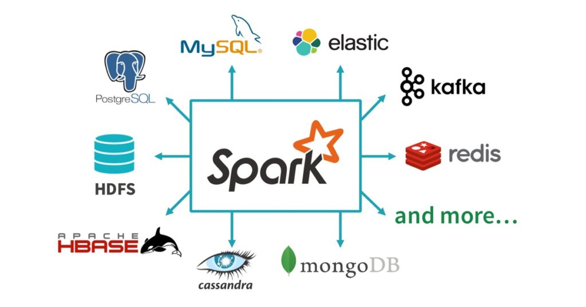
Apache Spark - Architecture
https://jaceklaskowski.gitbooks.io/mastering-apache-spark/spark-architecture.html

Slide 55
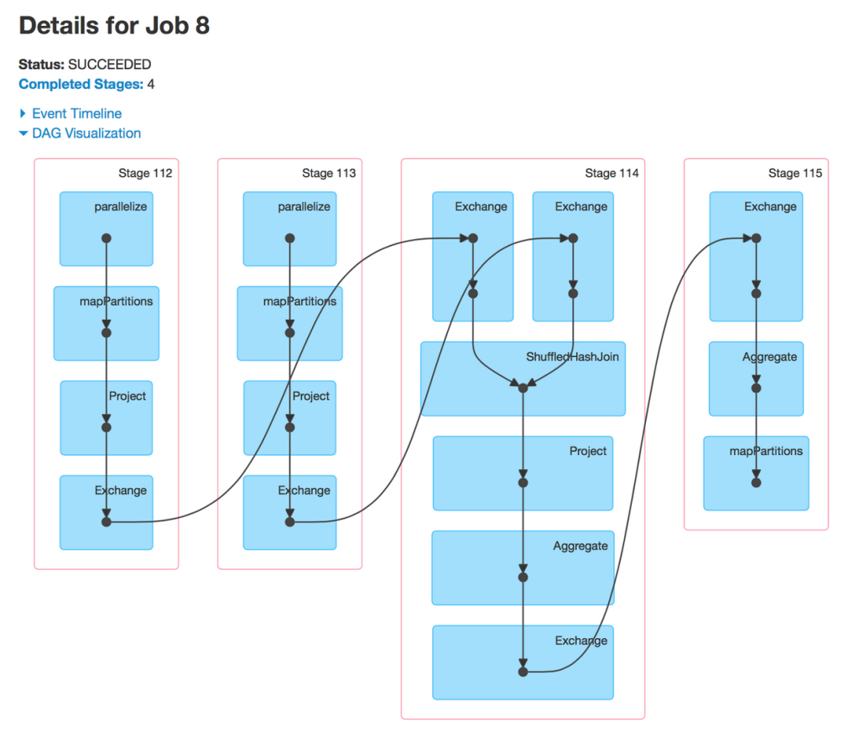
Apache Spark – Core API
Scala
Java
Python
R
SQL

Slide 56
Apache Spark - Basics
Transformations
Load, Map, Reduce, Filter, Fold
Actions
Collect,Save
Operation, optimisation of dag
Lineage recovery

Slide 57
Apache Spark – Databricks Experience
WebUI, Notebook,
Scalability
Multiple User
Data Science – Exploration
Demo

Slide 58
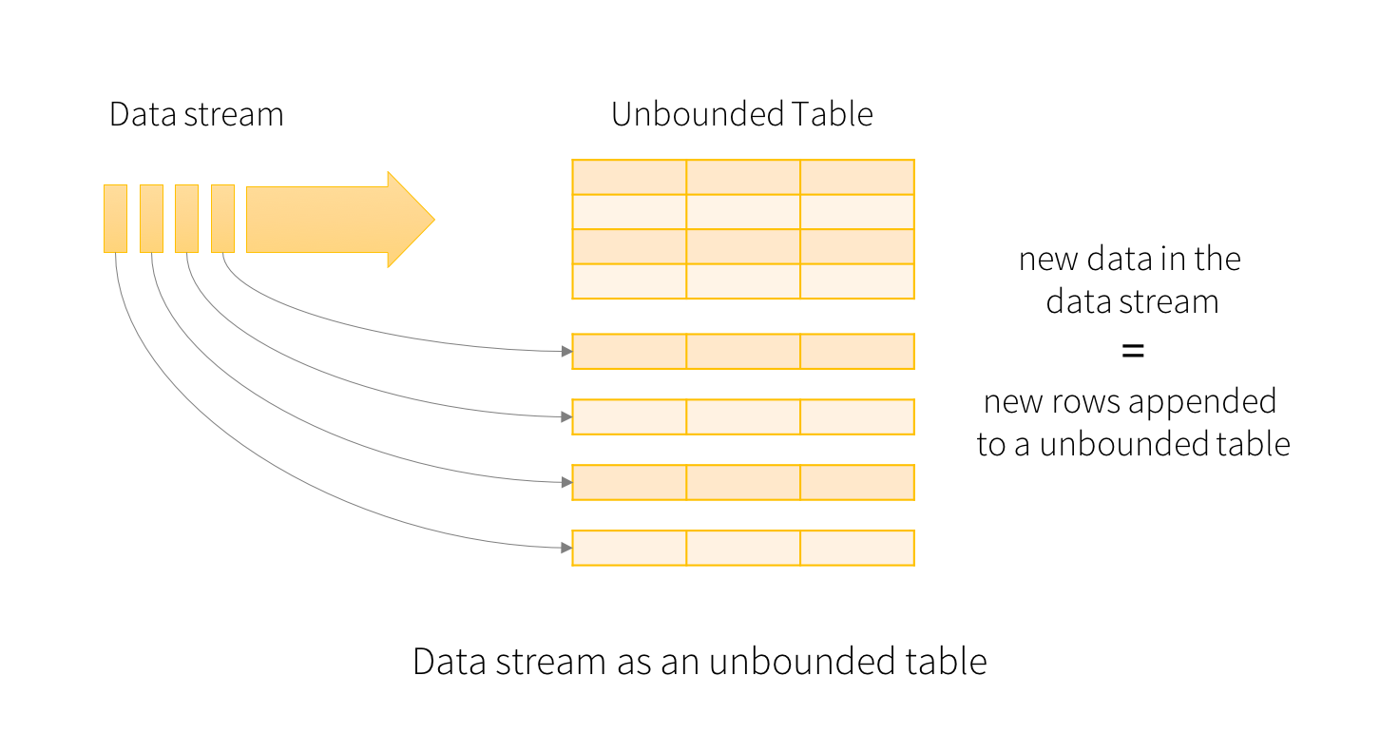
Apache Spark – Basic Concepts

Slide 59
Apache Spark – processing mode
Complete
Update
Append

Slide 60
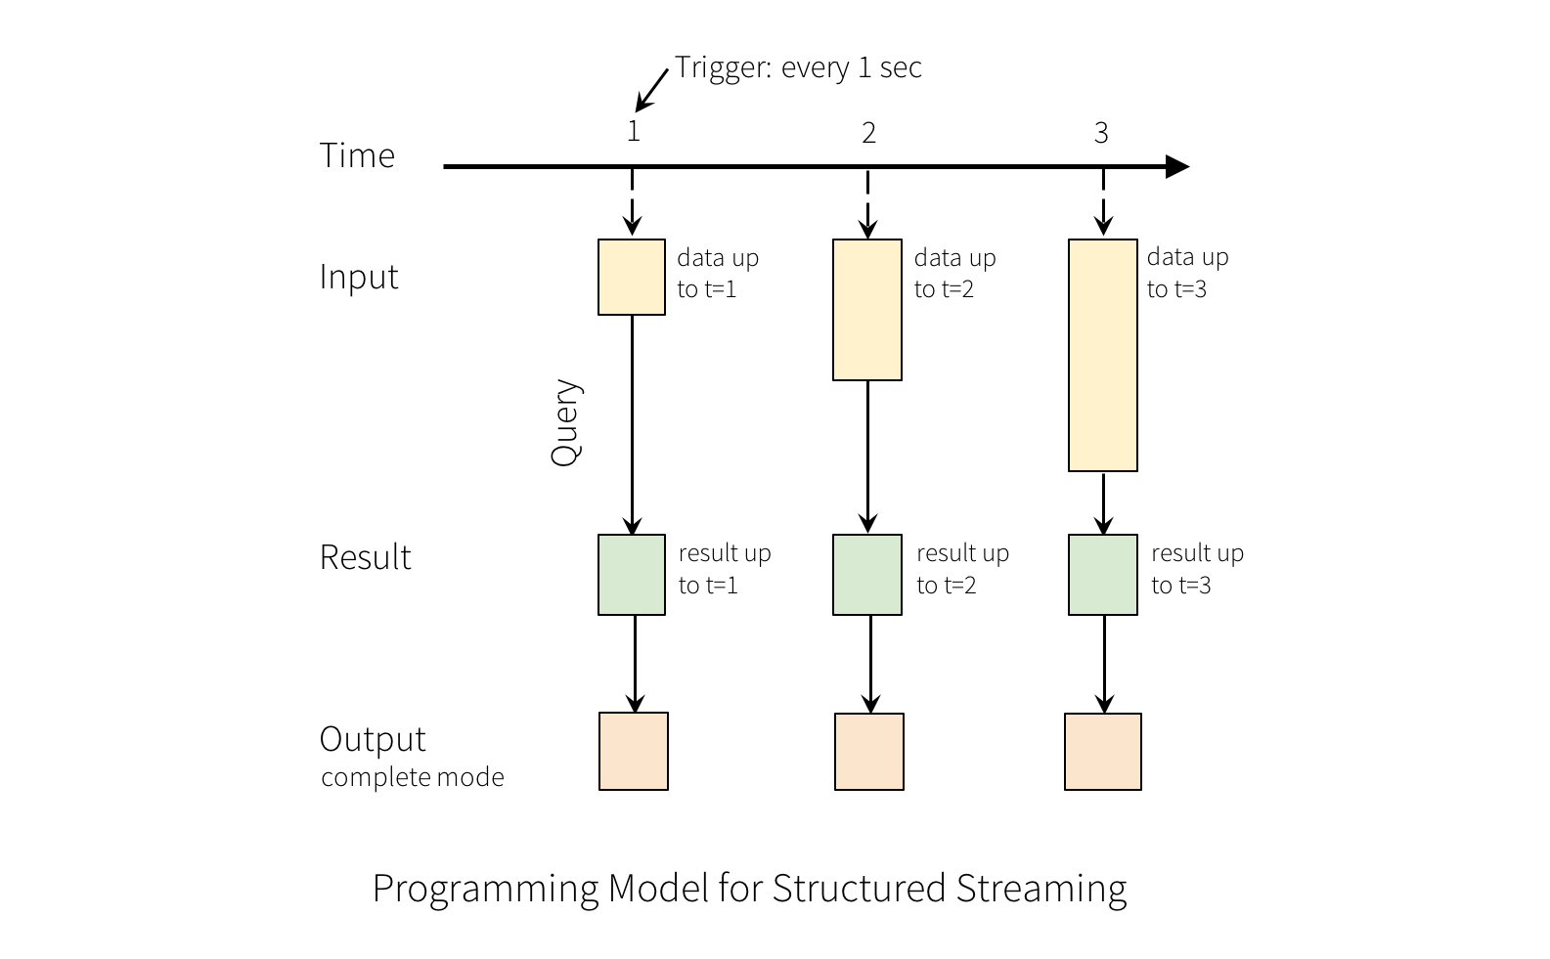
Apache Spark – example

Slide 61
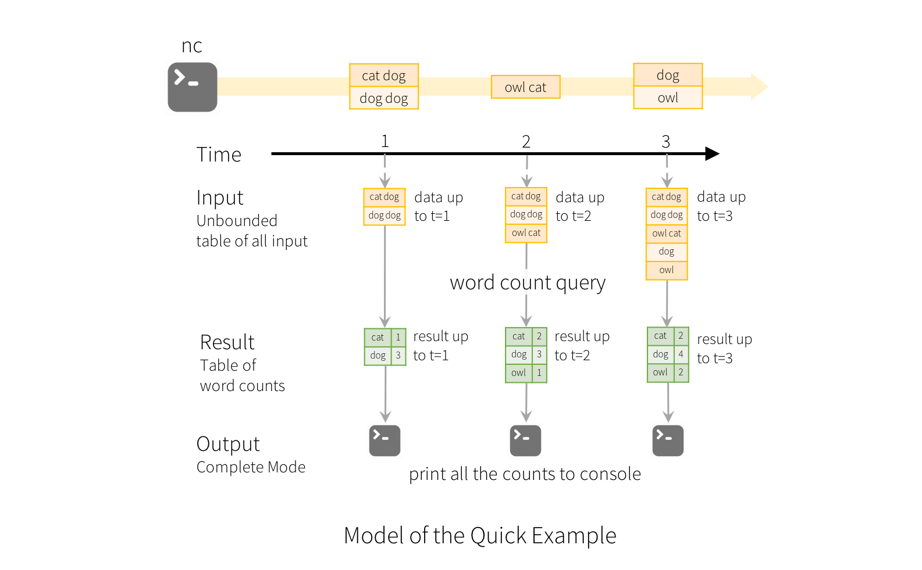
Apache Spark – example

Slide 62
Apache Spark – Information
Mikro-Batch
Triggers
Windowing
Late-Data
Watermarking
Exaclty-Once Fault-Tolerant processing

Slide 63
Exercise Spark Structure
Streaming

Slide 64
Exercise PowerBi and
Data Visualisation

Slide 65
Q&A

Slide 66
THANK YOU!

